Slide 1



The Bayesian R-matrix Inference Code Kit (BRICk)
James deBoer – University of Notre Dame
Dublin, OH campus of Ohio University, December 17 & 18, 2024

Slide 2
Phenomenological R-matrix fits
Models resolved resonance cross sections
Used in nuc astro to estimate very low energy charged particle induced cross sections by extrapolating based on higher energy data and indirect data
Used in nuclear data evaluation historically for neutron induced cross sections, but now also some charged particle induced data
⁴He(t,γ₀)⁷Li
S-factor (keV b)
Munch et al. (2020)
C.M. Energy (MeV)

Slide 3
A many parameter fitting problem
R-matrix parameterizes the cross section in terms of individual resonances
energies and reduced width amplitudes
About 10 parameters
100’s of parameters
⁴He(t,γ₀)⁷Li
S-factor (keV b)
Munch et al. (2020)
C.M. Energy (MeV)

Slide 4
The cross-section myth
Experimentalists like to call what we measure cross sections, but they are yields
That is, there is some distortion to the shape of the data that is the result of experimental resolution
We try to minimize it whenever possible, but it is always there at some level
Usually, we need to convolute our theory prediction with the experimental resolution for accurate comparison
We need to somehow figure out the experimental resolution function
It is usually very computationally costly to perform the convolution

Slide 5
Giveaways
There is often a shape difference
Breit-Wigner vs Gaussian

Slide 6
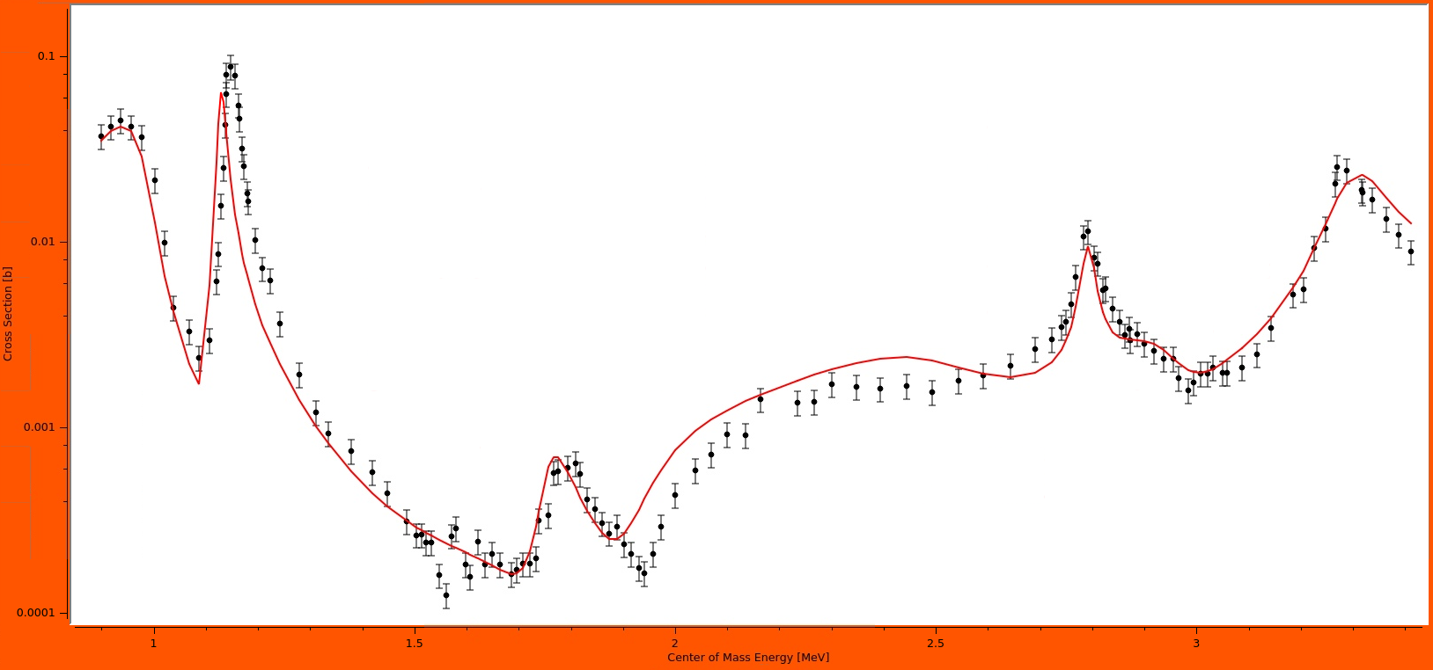
Energy uncertainty
Other data are pulling these resonances to different energies in this fit
Some energy calibrations are not consistent

Slide 7
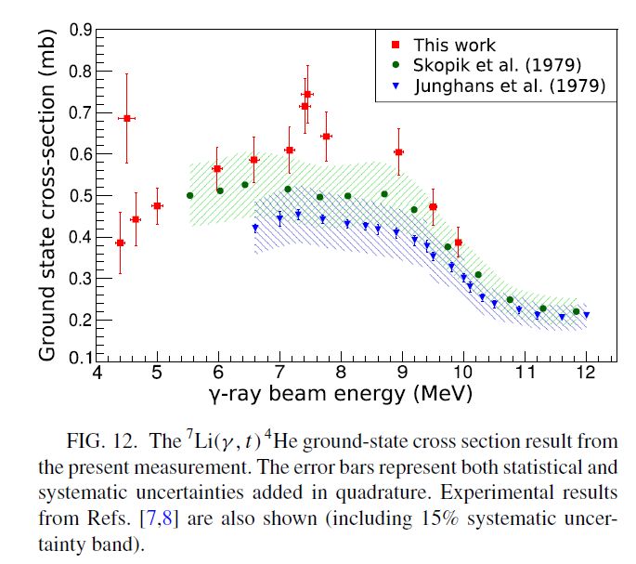
Absolute cross section uncertainty
Munch et al. (2020)
Point to point uncertainties and overall systematic uncertainties must be kept separate!
This type of uncertainty is usually implemented in most codes

Slide 8
We want to simultaneously fit many different data sets
These data sets have systematic uncertainties in both the absolute value of their cross section and their energy calibration and some experimental resolution function
Additional two (at least) fit parameters per data set, sometimes many more

Slide 9
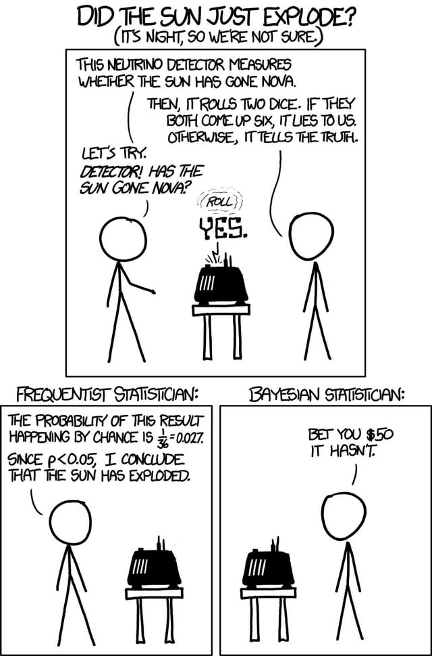
Why Bayesian?
Bayesian routines provide what is often a more convenient / straightforward way to implement these experimental resolution / calibrations into a fit
Bayesian methods are usually equivalent to frequentist approaches, its just that it is often easier to implement the Bayesian version in practice
xkcd: Frequentists vs Bayesians

Slide 10




AZURE2
R-matrix reaction framework for low energy nuclear reactions (JINA project)
Based on the FORTRAN code, AZURE,
developed by R.E. Azuma →
Written in C++, Graphical Interface created with Q(w)t
Ethan Uberseder →
Released in 2012
Utilizes currently maintained public libraries
MINUIT2
GNU Scientific Library
Open Source
Multiple entrance/exit channels
Particle, particle
Particle, gamma
Beta delayed particle emission
External capture calculation with E1 and E2
Citing articles: 211
(12/1/2024)
azure.nd.edu

Slide 11
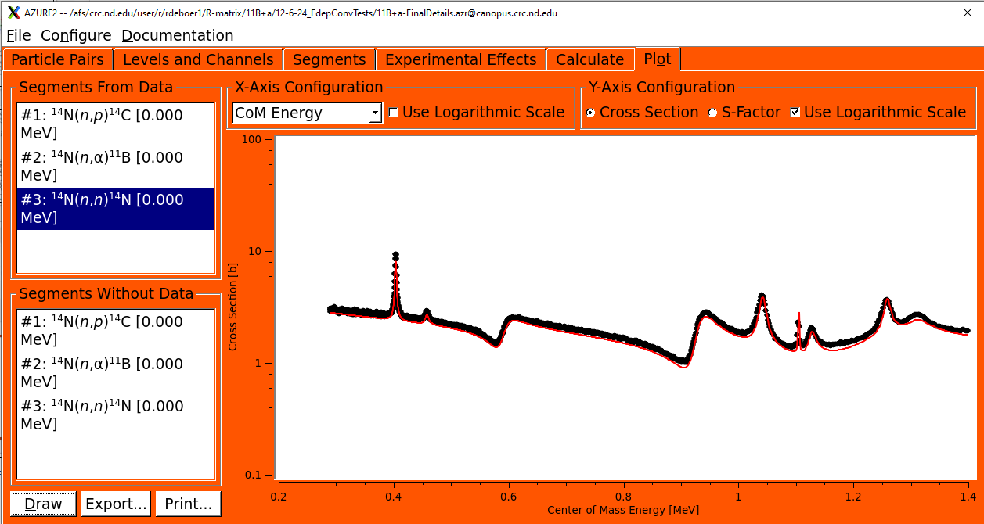
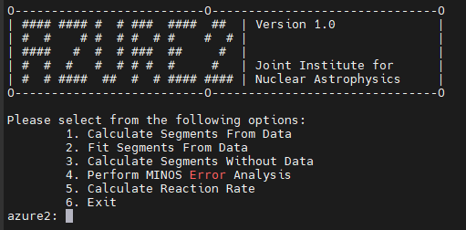
AZURE2 Modes of operation
Makes setting up calculations and often doing fits easier
Very useful for automating processes and can be called by other codes.

Slide 12
AZURE2 uncertainty analysis
Thompson et al. (2019)

Slide 13

How can we easily implement Bayesian uncertainty algorithms into AZURE2?
How can we easily test different ones?
There are many great routines already available in Python, but AZURE2 is written in C++.

Slide 14

How can we easily implement Bayesian uncertainty algorithms into AZURE2?
How can we easily test different ones?
There are many great routines already available in Python, but AZURE2 is written in C++.

Slide 15

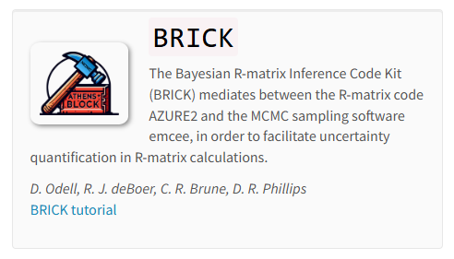
How can we implement these things in AZURE2?
https://bandframework.github.io/software/
Daniel Odell, OU

Slide 16
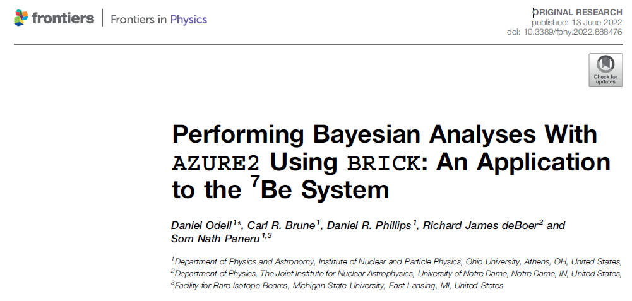
First test case: ³He(α,γ)⁷Be
Helped us better understand
Background levels
Tension between data sets
Energy shifts between data sets

Slide 17
Posterior PDFs, FTW
Easy calculation of posterior PDFs was really helpful in understanding different issues with the fit

Slide 18
As are correlation matrices

Slide 19
Energy variations
Still not a standard feature, but it was much easier to implement

Slide 20


BRICK highlight reel (2022 to present)

Slide 21
Immediately tried to do calculations with a lot more parameters
Several days on a 12 core machine
Just used to calculate parameter uncertainties

Slide 22
Nature
The ubiquitous corner plot
Used to calculate the uncertainties in R-matrix fit of the ¹⁹F(p,γ)²⁰Ne data from JUNA

Slide 26
Calculation of parameter correlations really helped a lot

Slide 28
IReNA virtual tutoring
Essential for understanding parameter correlation
Implemented energy shifts for some data sets

Slide 29
Beyond EMCEE
It turns out that BRICK can be used in a more general sense, it can “easily” be adapted to provide an interface for any python package
Jakub Skowronski, “super user” of BRICK has been doing a bunch of comparison calculations with other minimization routines
Publication in preparation

Slide 30
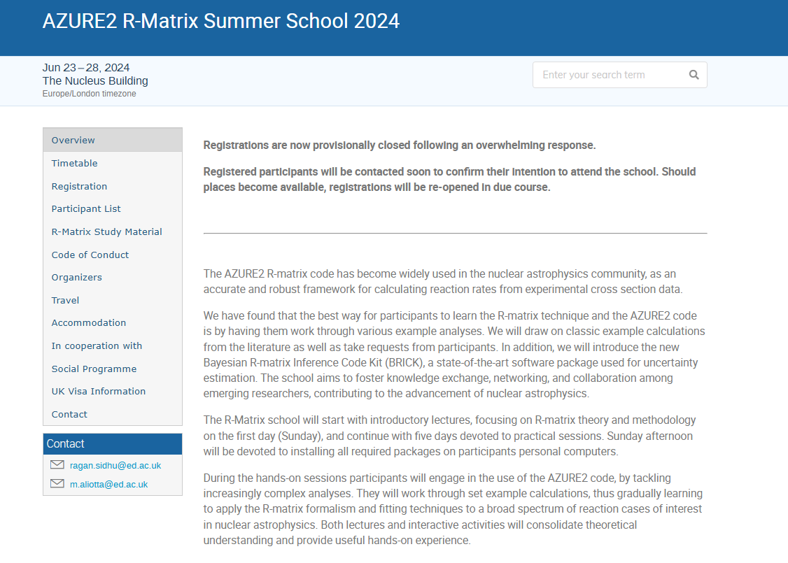
Lots of example material can be found at
Marialuisa Aliotta and Ragan Sidhu at University of Edinburgh
Lots of really great material available on the website
https://indico.ph.ed.ac.uk/event/274/

Slide 31
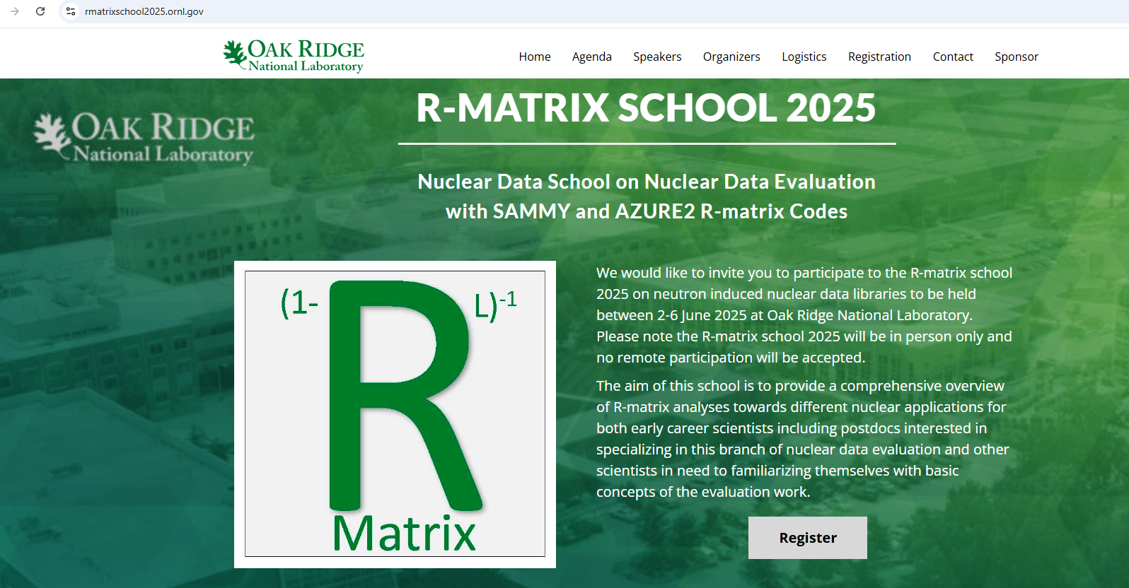
(& 2027 & 2029)
Organizers/Lecturers
Marco Pigni
Doro Wiarda
Carl Brune
James deBoer

